Slide 1
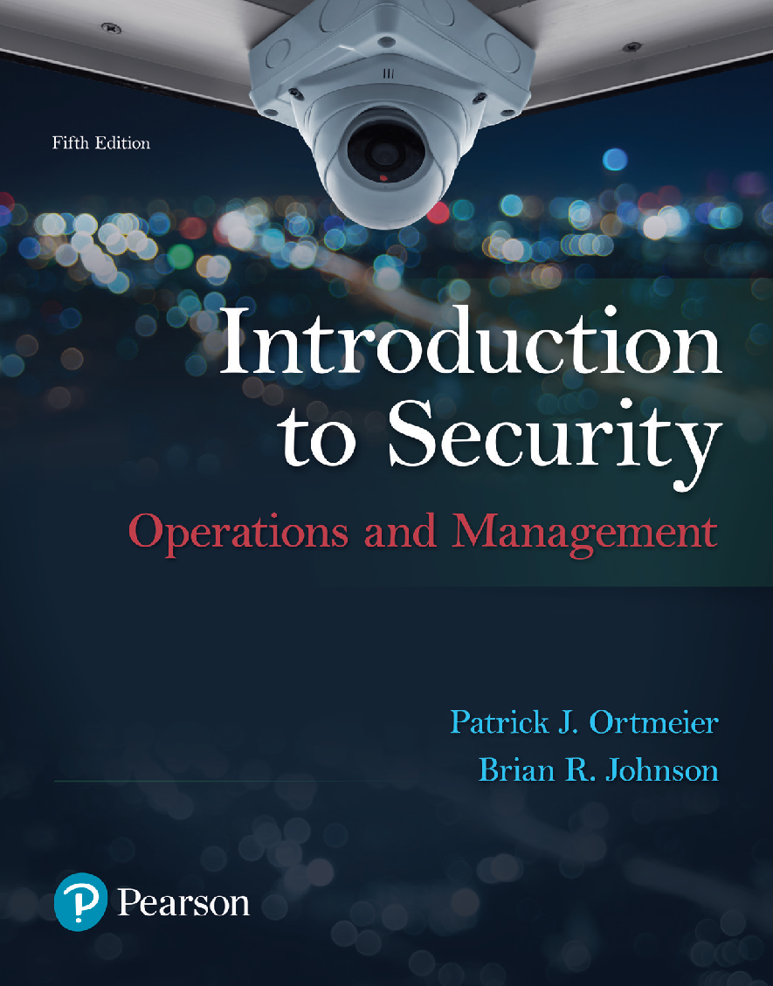
Introduction to Security: Operations & Management
5th Edition
Chapter 12
Risk Assessment, Security Surveys & Continuity Planning

Slide 2
Learning Objectives (1 of 2)
After completing this chapter, the reader should be able to
1. Define risk
2. Describe and explain the risk management process
3. List and describe the types of risk that threaten individuals and organizations.
4. Explain the Risk Assessment process
5. Explain the purpose of security surveys
Notes:
Slide 2 is list of textbook LO numbers and statements

Slide 3
Learning Objectives (2 of 2)
6. Determine risk based on vulnerability, probability, and criticality of loss.
7. Discuss management techniques associated with risk elimination, reduction, and mitigation.
8. Explain the purpose of business continuity plans
9. Understand the main components disaster contingency plans.
10. Evaluate risks to determine vulnerability, probability, and criticality of loss.
Notes:
Slide 2 is list of textbook LO numbers and statements

Slide 4
Introduction

Slide 5
The Concept of Risk (1 of 2)
Risk:
  Definitions
  Key Elements
Risk Management:
  Definitions
  Elements of the Risk Management Process

Slide 6
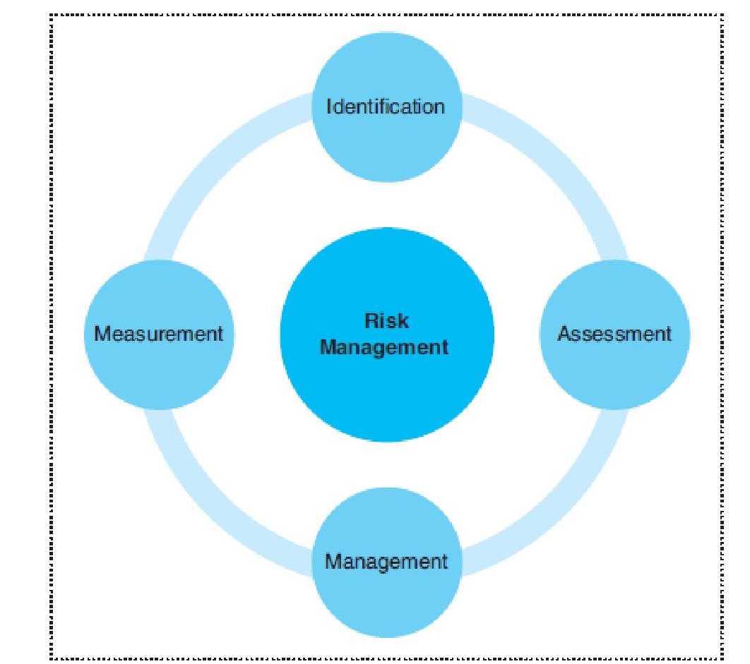
The Concept of Risk (1 of 2)
The Risk Management Cycle:

Slide 7
Identifying Risk (1 of 2)
Dynamic Risk:
Static Risk:
Pure Risk:

Slide 8
Identifying Risk (2 of 2)
Speculative Risk:
Operational Risk:
Legal Risk:
Reputational Risk:

Slide 9
Risk Assessment Techniques (1 of 4)
Introduction/Definitions:

Slide 10
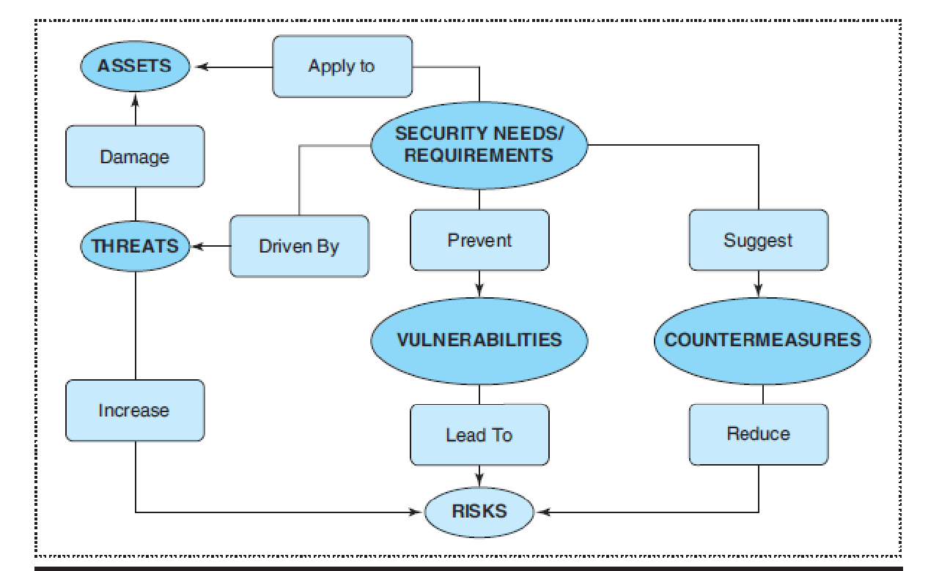
Risk Assessment Techniques (2 of 4)
Common Criteria Security Model:

Slide 11
Risk Assessment Techniques (3 of 4)
Security surveys:
Completing security surveys:

Slide 12
Risk Assessment Techniques (4 of 4)
Determining risk levels:
Quantifying risk: Examples:

Slide 13
Risk Management Techniques (4 of 4)
Introduction/Definitions:
Risk management techniques:
  Avoidance
  Reduction
  Spreading
  Transfer
  Acceptance

Slide 14
Continuity & Contingency Planning (1 of 2)
Introduction/Definitions:
Continuity plans:

Slide 15
Continuity & Contingency Planning (2 of 2)
Contingency plans:
Continuity plans & emergency management:
  Key Points
  NIMS
  National Response
  Main Components

